Slide 1
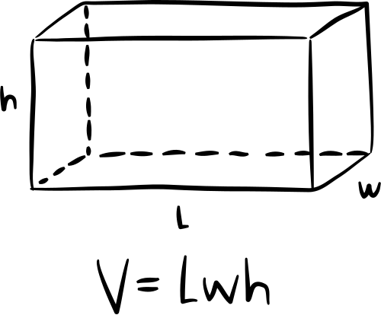
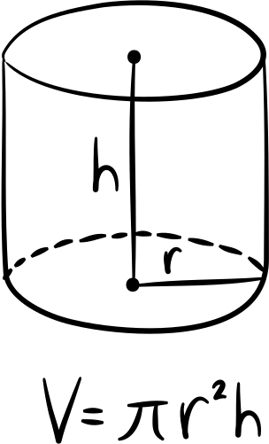
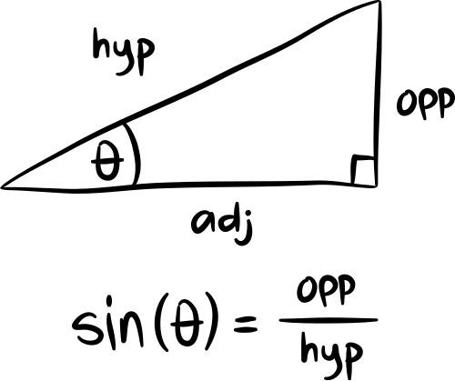
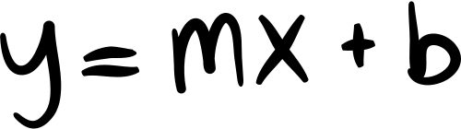
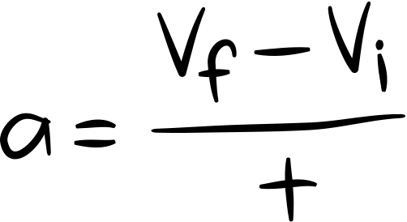
Design & Analysis of Algorithms
Closest-Pair Problem by Divide-and-Conquer
shahenaz saied
224499

Slide 2
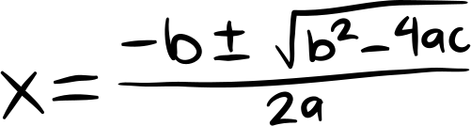
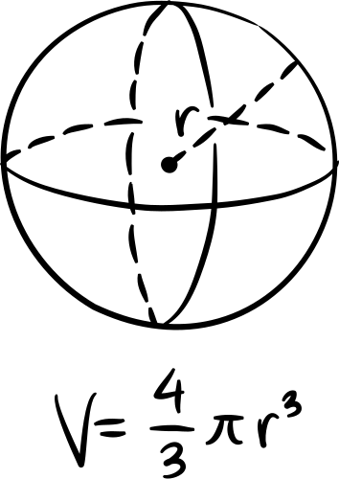
Learning Target:
I will be able to understand and solve the 2D closest pair algorithm divide and conquer

Slide 3
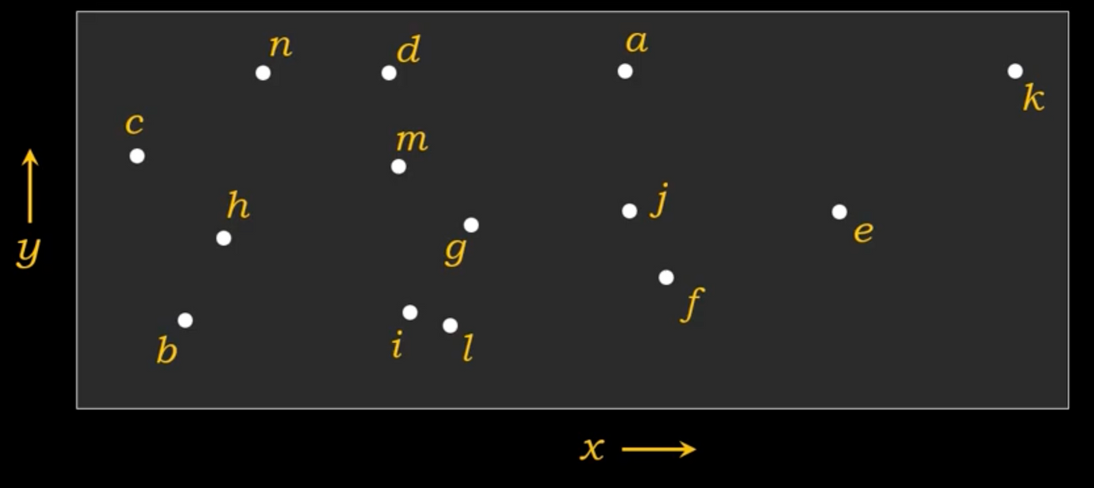
closest pair problem:
problem: given a set of n points in 2d space find the pair of points with the minimum distance between them
There is a two way to solve the problem:
1)Brute-force O(n^2) time complexity
this mean it need alot of time to sollve the problem and compare all the point to each other so we will use divide and conquer

Slide 4
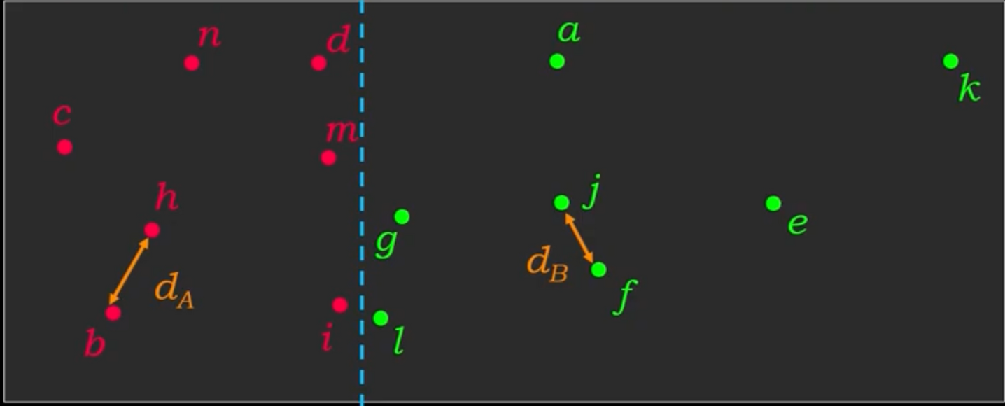
main steps :
1)Divide the set of points into two halves recursively
2) find the closest pair in each half recursively in each half (d)
3) merge the two halve and find the closest pair across the split

Slide 5
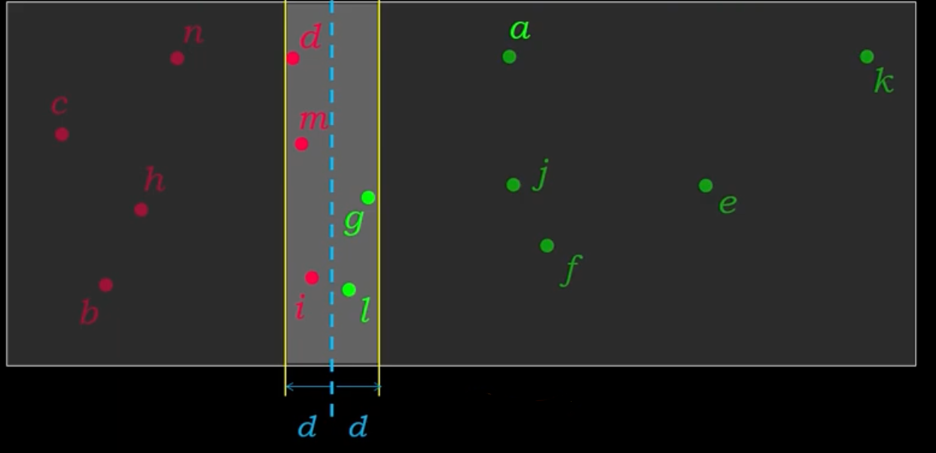
lets see in details:
create astip of width 2d centered around the dividing line
consider only the points within the strip sort these points by their y-coordinates
for each point in the strip compare its distance the next point
update the minimum distance if a closer pair is found

Slide 6
Compare the points inside this box with each other only,
so that the points have been verified to meet the condition.
"Some people may ask another question":
While it is not possible to know a specific number of points within the rectangle, which results in an indefinite number of comparisons,
how can we have found a solution to the problem with other algorithmic methods?

Slide 7
the code (python ):
ClosestPairDivideAndConquer(points):
if len(points) <= 3:
return ClosestPair BruteForce(points)
mid = len(points) // 2
leftPoints = points:mid]
rightPoints = points[mid:]
leftMinDistance, leftClosestPair =
ClosestPair DivideAndConquer(leftPoints)
rightMinDistance, rightClosestPair =
Closest Pair DivideAndConquer(rightPoints)
minDistance = min(leftMinDistance, rightMinDistance)
if minDistance == leftMinDistance:
closestPair = leftClosestPair
else:
closestPair = rightClosestPair
midStrip =[]
for point in points:
if abs(point[0] - points[mid][0]) <
minDistance:
midStrip.append(point)
stripMinDistance, stripClosestPair =
ClosestPairStrip(midStrip, minDistance)
if stripMinDistance < minDistance:
minDistance = stripMinDistance
closestPair = stripClosestPair
return minDistance, closestPair

Slide 8
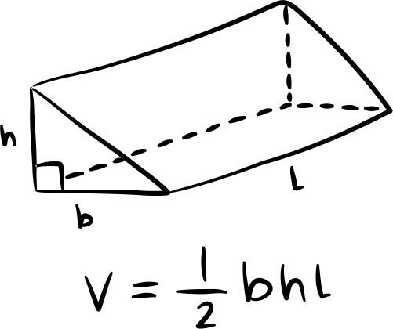
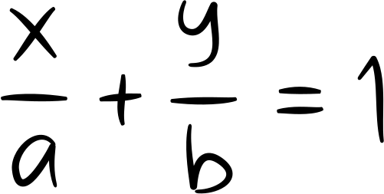

Key Words:
Let T(n) denote the time complexity for solving a problem of size n
Sort the points by their x-coordinates (O(n log n)).
Divide the sorted points into two equal halves (O(n)).
0(n log n) + 0(n) = 0(n log n)
Recursively find the closest pair in each half
(2 * T(n/2)).
Consider only points within the strip (O(n)).
Sort these points by their y-coordinates (O(n log n)).
Compare each point to its closest neighbors (O(n)).
Update the minimum distance if a closer pair is found.
0(n) + O(nlog n) + O(n) = O(n
Total:
T(n) = 2T(n/2) + O(n log n)
Applying the Master Theorem :
A=2, b=2, b^d=2 → a=b^d
T(n)=> n^d log n
=> T(n) = 0(n log n)
Therefore, the closest pair divide-and-conquer algorithm has a time complexity of O(n log n),
which is significantly faster than the brute-force approach with a complexity of O(n^2).

